Slide 1
A presentation of
and our products

Slide 2
Our business idea
To develop, manufacture and
market equipments
for rational lubrication
Notes:
Assalub is focusing on one area only!

Slide 3
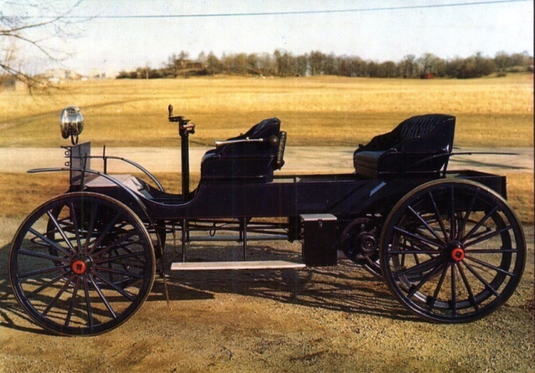
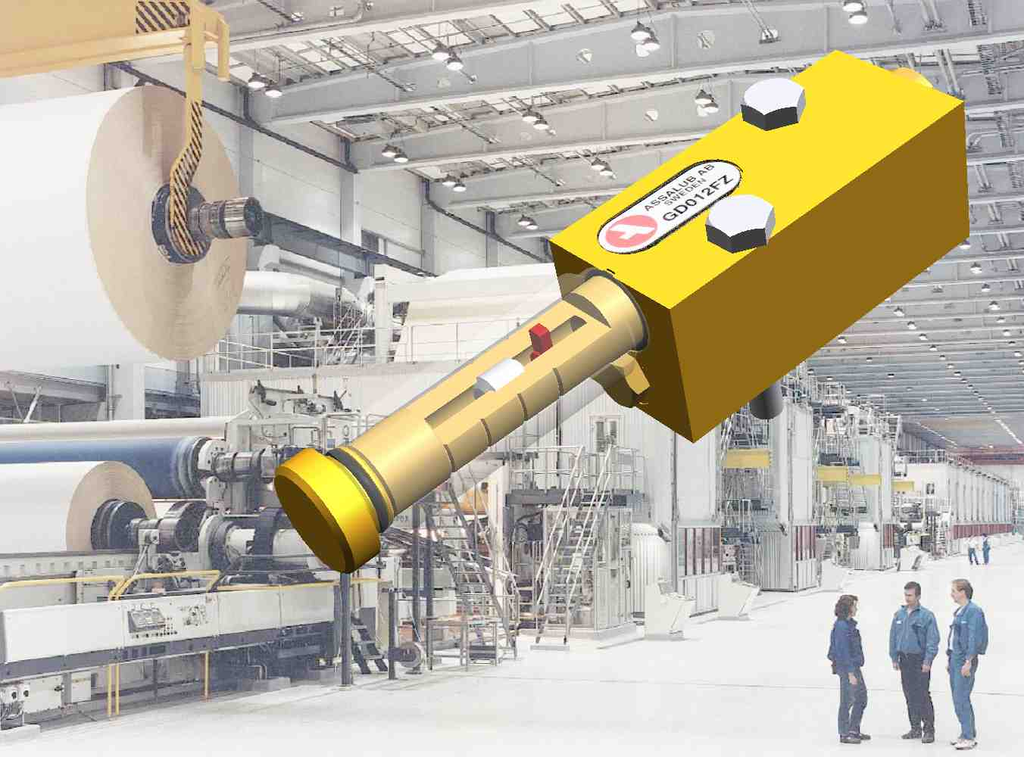
History
1908 Åtvidabergs Vagnfabrik
1910 Car production
1917 ÅSSA – Åtvidabergs spårväxel och signalfabrik AB
1928 Lubricators
1958 Aircraft hydraulics
1985 Air driven barrel pumps
1986 Safematic AB
1993 Assalub AB
Notes:
1908 Carriage factory of Åtvidaberg. 1917 Factory for turn-outs and signal equipments (for rail roads) of Åtvidaberg.
Aircraft hydraulics: The hydralic motor activating the radar antenna in the very front of the aircraft body was designed and manufactured by our company. Our customer was Ericsson and the motors were delivered to three generations of Saab fighters.

Slide 4
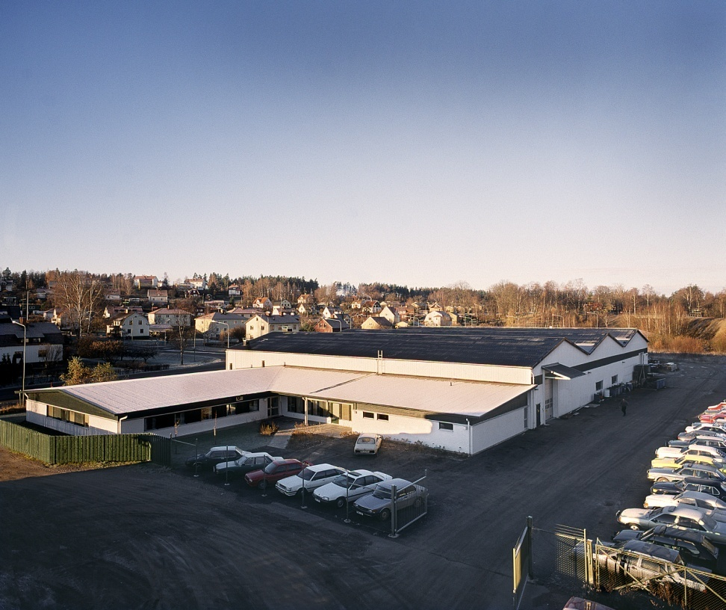
Facts
ASSALUB AB has 85 years experience in development & manufacturing of high quality lubrication equipment for heavy process industry.
The HQ and factory are located in Åtvidaberg.
Turn-over: EUR 4,2 millions
Employees: 40
Notes:
Assalubs factory and HQ

Slide 5
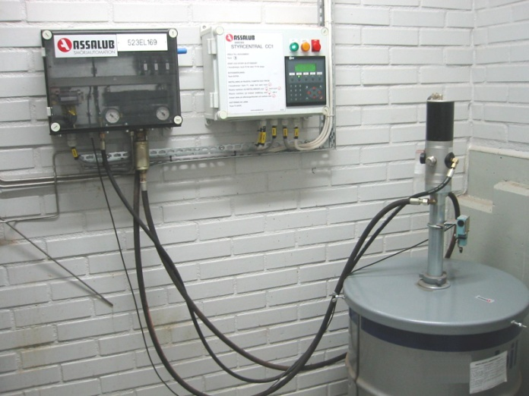
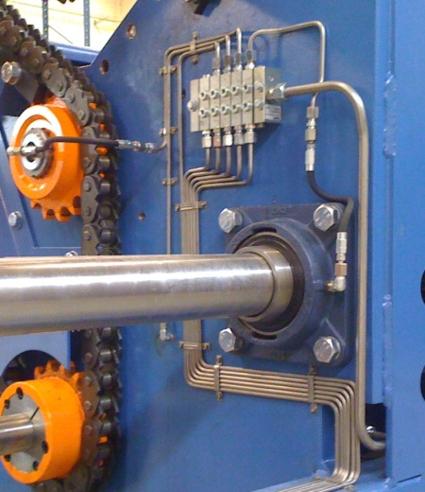
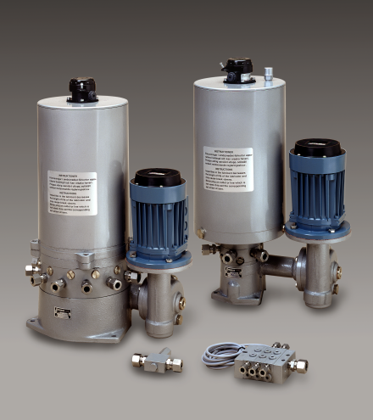
Industrial lubrication
Dual-line systems
Multi line systems
Circulation systems
Single line progressive systems
Notes:
A wide range of products mainly designed for the Heavy Process industry.

Slide 6
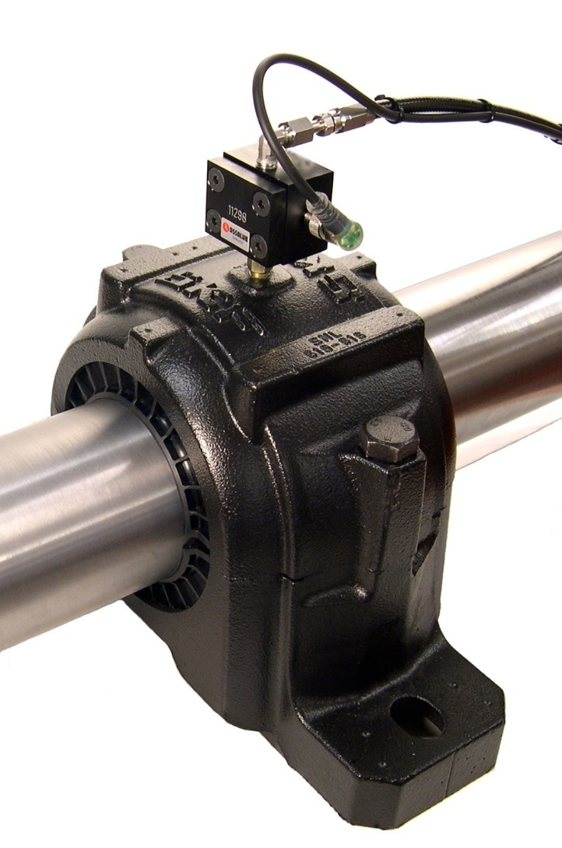
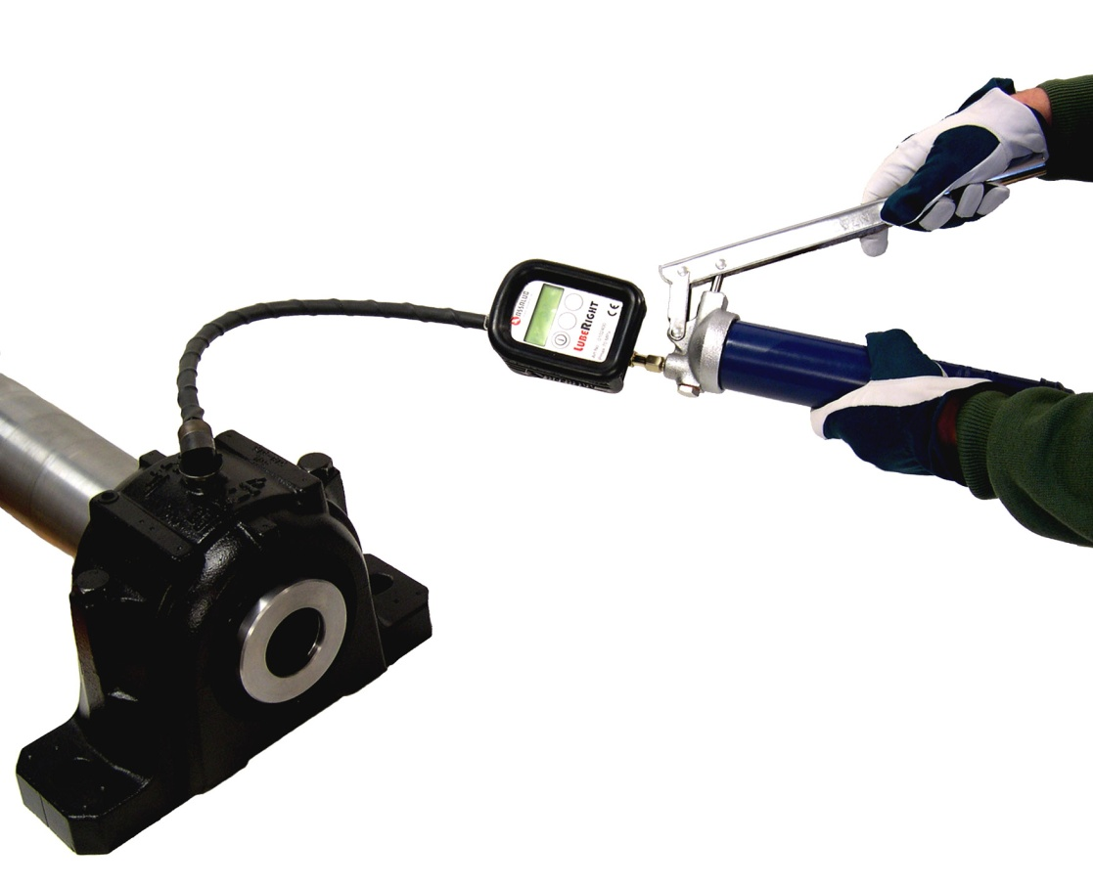
Unique products
Notes:
Here is two unique lubrication products.
LubeRight is a computer-aided manual greasing system with RFID-identification of each lube point.If the greaser adds to much grease or too little or if he simply forgets to grease – LubeRight will tell him!
LubeMon is a device that is attached directly on the bearing and it tells how much lubricants has been fed into the bearing.

Slide 7
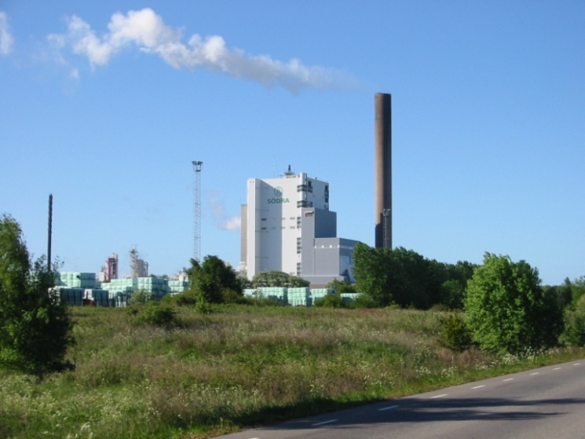
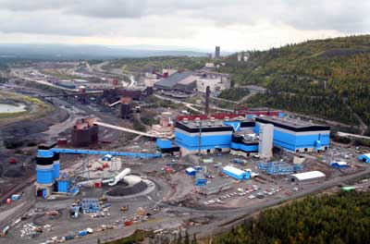
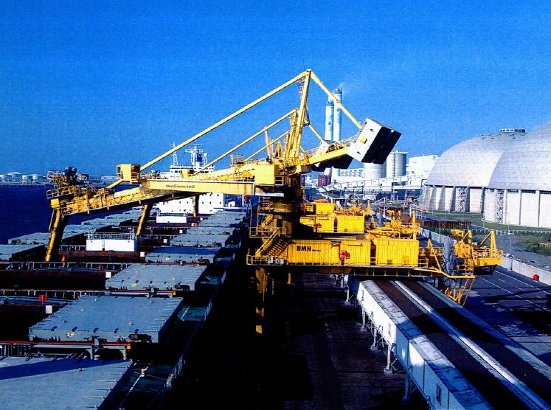
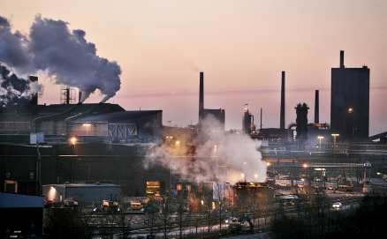
Customers
Energy producing industry
Paper & Pulp mills
Mines
Cement industry
Primary metal
OEMs
Notes:
Typical customers

